Slide 1
Predicting Inpatient Length of Stay in Hospitals
Lidiia Tronina
City University of New York School of Professional Studies
DATA 698 - Capstone
December 9, 2022

Slide 2
Introduction
Hospital stays in the U.S. cost insurance companies at least $377.5 billion per year[1]
Recent Medicare legislation standardizes payments for the procedure performed, regardless of the number of days a patient spends in the hospital
LOS also has a significant impact on patient experience. Patients don’t want to stay at the hospital longer than necessary.
Longer lengths of stay also negatively impact hospitals. They increase costs and are often linked to inefficiency—indicating that processes may need to be revisited.
When a patient is kept in a bed longer than necessary, it may mean that the bed is not available for another patient who needs it more.
Increasing healthcare costs and availability of a large volume of medical data motivate the search for ways to increase the care efficiency.

Slide 3
Length of Stay is ongoing area of research
While there is a high accuracy in predicting LOS as a categorical variable, there is room for improvement for prediction as a continuous variable.
R-squared of regression models peaks in the .30 range:
Wide range of classiﬁcation and regression techniques using various datasets datasets:
Classification:
Random Forests[2]
Boosted Decision Trees[3]
Regression
Gradient Boosting
K Neighbors
Linear
Random Forest[4]
Technique | Accuracy
Classification Models | 0.70 - 0.75
Regression models (R2) | 0.26 - 0.39

Slide 4
Hypothesis/Research Question
The hypothesis is that the length of stay predictions can be made based on patient demographics, diagnosis, condition severity, insurance, and type of admission.
This analysis focuses on predicting length of stay in the hospital at time of admission as a continuous variable, hence, the more accurate predictions compare to other researchers in this area.
The author also seeks to extend the body of research by focusing on improving the feature selection and engineering and improving the accuracy of LOS predictions as a continuous variable.
Ultimately the author seeks to answer whether the length of stay in hospital can be predicted at time of admission and gain knowledge on what contributes to longer stays in the hospital.
Factors to be considered are:
whether there is a negative dynamic in any specific hospital over a number of years;
whether the type of insurance a patient has affects LOS;
whether there is a difference in LOS before and after the COVID-19 pandemic.

Slide 5
Mount Sinai Hospital Dataset
Feature | Description | Type
Facility | Identifies the hospital where the patient was admitted | Categorical
Year | Year when patient was admitted to inpatient care | Categorical
Month | Month when patient was admitted to inpatient care | Categorical
Age | Patient’s Age | Continuous
Race | Patient's Race | Categorical
Gender | Patient's Gender | Categorical
Type of insurance | Groupings of like payers into high-level categories, i.e. Commercial, Medicare HMO, Medicare, Medicaid etc. | Categorical
Type of Admission | Distinguishes whether the admission was emergent, elective, urgent, traumatic, or newborn. | Categorical
DRG | MS DRG (Medicare Severity Diagnosis Related Group) Code. Groups patients into categories based on clinical and resource consumption similarities. | Categorical
DRG Severity | There are 4 possible options - 1: Minor, 2: Moderate, 3: Major and 4: Extreme. | Categorical
Diagnosis | Identifies the diagnosis that led to the patient being admitted for inpatient treatment. | Categorical
Readmission Flag | Qualifying inpatient encounters within 30-days prior to the current admission will have a value of Y. | Categorical
Risk of Mortality Score | Premier-defined expected mortality for the admission. | Continuous
Risk of Mortality Categorical | Categorical variable that measures relative risk of death during admission within a given DRG. | Categorical
The dataset contains over 900,000 hospital admissions from 7 New York hospitals.
The admission data were collected continuously from 2015 to the present (2022)
This 14 features and 1 target variable are taken from the original dataset

Slide 6
Mount Sinai Hospital Dataset
Furthermore, the following parameters will be added to the dataset:
Age Group
About 10% of all inpatient admissions in the Mount Sinai data are newborns with age ‘0’. It makes sense to group age by category.
COVID-19 diagnosis flag.
Post COVID admission flag. Patient admitted after 03/01/2020
Emergency Department Admission Indicator
It is also important to exclude admissions that resulted in death since they can affect the accuracy of the model.

Slide 7

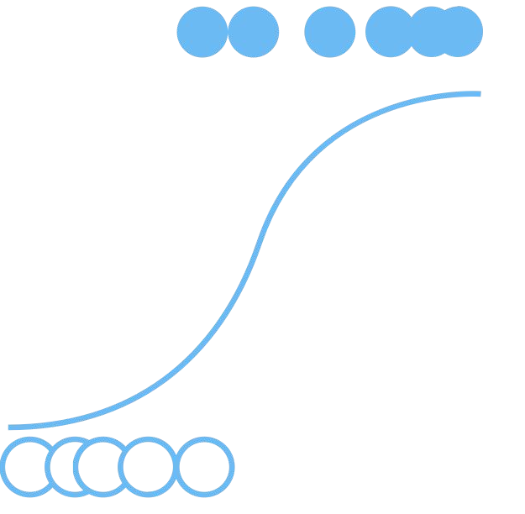

Model Building
The following models were trained and then validated on the test data, and their accuracy scores computed:
Additional Parameter Tuning
DRG Groups
Outlier Exclusions
Transformation into numeric format(KNN)
Predictors with high collinearity excluded
Ridge
Regression
Poisson
Regression
K-nearest Neighbor
Regression
Linear Regression
The final dataset included information from 914,645 hospital admissions.
Once the data was in a model-ready format, it was split into a training data set and a testing data set with a train-test split of 70% training and 30% testing

Slide 8
Results
The lower value of MAE, MSE, and RMSE implies that Linear regression has the highest accuracy when compared to the other models.
Even though the choice of models was limited, we were able to build a model with R2, similar to previous researchers in this area.
Using this model we can gain knowledge on factors contributing to longer stays in hospital.
Model Name | R-squared | MSPE | MAE | RMSE
Linear Regression | 0.35 | 24.44409 | 2.821081 | 4.944096
Penalized Regression | 0.35 | 24.44666 | 2.819887 | 4.944357
Poisson Regression | - | 48.56436 | 3.853134 | 6.968813
K-nearest Neighbor Regression | - | 28.43573 | 2.963692 | 5.332517

Slide 9
References
[1] Cummings, D. (2020, May 11). Predicting hospital length-of-stay at time of admission. Medium. https://towardsdatascience.com/predicting-hospital-length-of-stay-at-time-of-admission-55dfdfe69598
[2] Chrusciel, J., Girardon, F., Roquette, L., Laplanche, D., Duclos, A., & Sanchez, S. (2021). The prediction of hospital length of stay using unstructured data. BMC Medical Informatics and Decision Making, 21(1). https://doi.org/10.1186/s12911-021-01722-4
[3] Tien, V. (2020, June 4). Predicting Inpatient Length of Stay at Hospitals Using Python + Big Data. Medium. https://towardsdatascience.com/predicting-inpatient-length-of-stay-at-hospitals-using-python-big-data-304e79d8c008
[4] Cummings, D. (2020, May 11). Predicting hospital length-of-stay at time of admission. Medium. https://towardsdatascience.com/predicting-hospital-length-of-stay-at-time-of-admission-55dfdfe69598

